Slide 1
University of Basrah
AL-Zahraa College of Medicine
Ministry of higher Education and Scientific Research
Internal medicine block
6th grade Al-Zahraa college of medicine
Monday 24/7/2023
Congo crimson hemorrhagic fever
Block members:
Dr Mustafa Emad (block leader)
Dr Firas Rashid Dr Qutaiba Muslim Dr Mohammed Adel Dr Ahmed Ibrahim Dr Zuhair Abdulkareem Dr Karem Basil Dr Ahmed Qassim Dr Hisham Dr Nassir Tarish Dr Ahmed Adnan Dr Mohammed Mehdi Dr Ahmed Jafaar Dr. Ali abdulridha Dr.Raghid Abdullateef

Slide 2
University of Basrah
AL-Zahraa College of Medicine
Ministry of higher Education and Scientific Research
Objectives
Basic background about the epidemiology, clinical presentation, diagnostic workup and management of Congo-Crimean viral hemorrhagic fever.
Highlighted the newly formed management algorithm in collaboration with the WHO team
Discuss the changes in incidence and mortality in the last month.

Slide 3
University of Basrah
AL-Zahraa College of Medicine
Ministry of higher Education and Scientific Research
Overview
• CCHF is viral illness that occurs in Africa, the Balkans, the middle east and Asia, in countries south of the 50° parallel north.
• The principal reservoir and vector of CCHF are ticks of the genus hyalomma, although other tick genera can be infected with CCHF virus.
• The CCHF virus is transmitted to humans mainly by tick bites or through contact with infected animal blood or tissues during and immediately after slaughter.
• 88% of people infected will have subclinical symptoms.
• One in eight people with symptomatic disease will develop a severe disease.

Slide 4
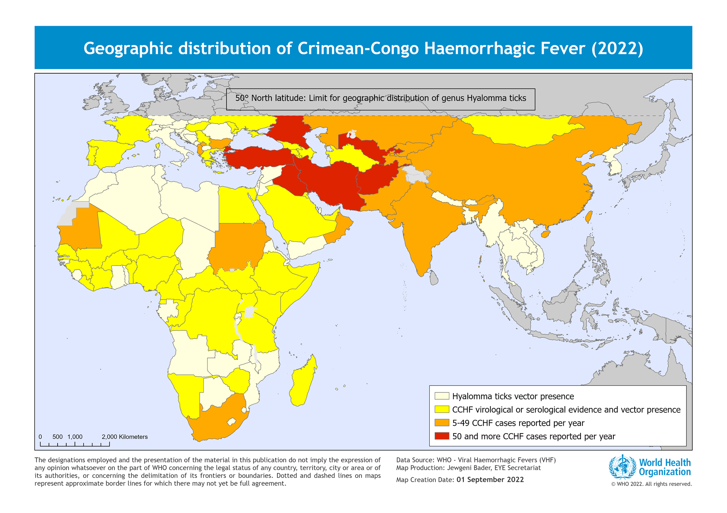
University of Basrah
AL-Zahraa College of Medicine
Ministry of higher Education and Scientific Research

Slide 5
University of Basrah
AL-Zahraa College of Medicine
Ministry of higher Education and Scientific Research

Slide 6
University of Basrah
AL-Zahraa College of Medicine
Ministry of higher Education and Scientific Research

Slide 7
University of Basrah
AL-Zahraa College of Medicine
Ministry of higher Education and Scientific Research
Pathogenesis
A common pathogenic feature of hemorrhagic fever viruses is their ability to disable the host immune response by attacking and manipulating the cells that initiate the viral response. This damage is characterized by marked replication of the virus together with dysregulation of the vascular system and lymphoid organs.
Endothelial damage contributes to hemostatic failure by stimulating platelet aggregation and degranulation, with consequent activation of the intrinsic coagulation cascade.
Indeed, fatal CCHF cases had grossly abnormal indicators of coagulation system function from an early stage of illness, and disseminated intravascular coagulation is noted as an early and prominent feature of the disease process.

Slide 8
University of Basrah
AL-Zahraa College of Medicine
Ministry of higher Education and Scientific Research
Clinical presentation
The incubation period ranges from 2-14 days.
• 70% of CCHF cases have a history of tick bite (but not the case in our locality !!!)
• It is estimated that 88% of infections are subclinical.
• Case fatality ratio can reach 15% among patients hospitalized with severe presentation.
• Most common symptoms include:
Abrupt onset fever, chills, shudders, myalgia, headaches, sicknesses and vomits, abdominal pain, arthralgia;
After a few days: bleeding from mucous membranes, hematomas, ecchymosis, melena, hematuria, nose bleeding, vaginal bleeding, bradycardia, thrombocytopenia, leukopenia.

Slide 9
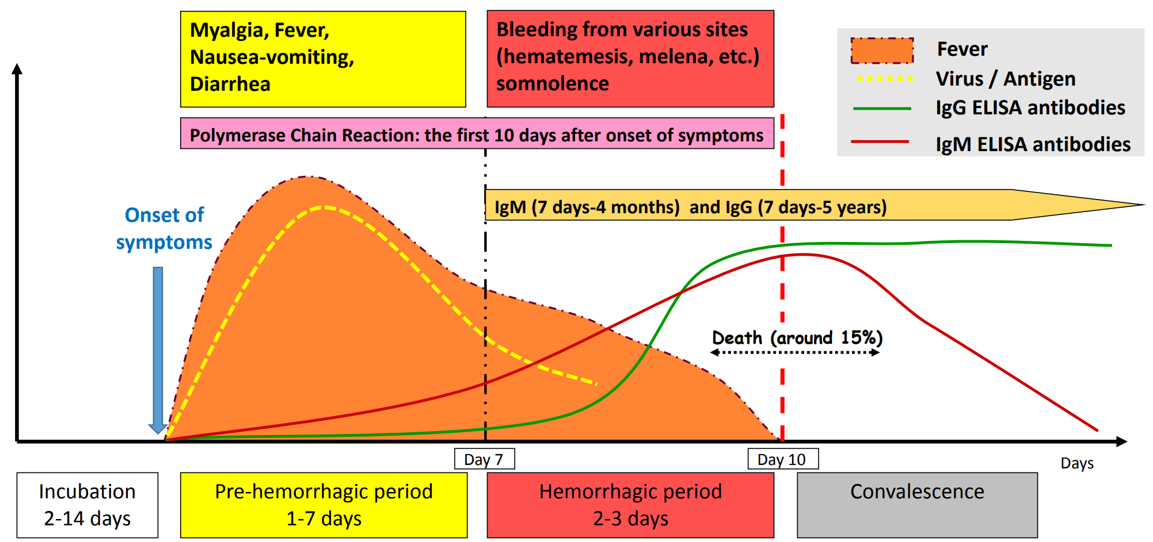
University of Basrah
AL-Zahraa College of Medicine
Ministry of higher Education and Scientific Research
Evolution of symptoms

Slide 10
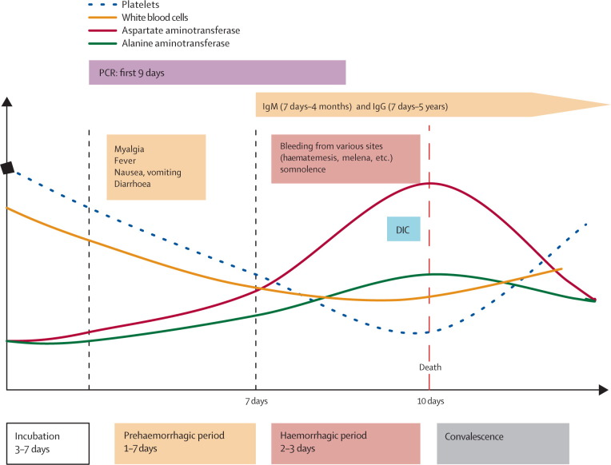
University of Basrah
AL-Zahraa College of Medicine
Ministry of higher Education and Scientific Research

Slide 11
University of Basrah
AL-Zahraa College of Medicine
Ministry of higher Education and Scientific Research
Differential diagnosis
Other viral hemorrhagic fevers
Fever plus hemorrhage
Malaria
Typhoid fever
Shigellosis
Hematological malignancies
Patient history is essential and should include exposure to ticks; or exposure to wild animals and livestock; and/or area/village endemic for CCHF; and/or contact with CCHF cases.

Slide 12
University of Basrah
AL-Zahraa College of Medicine
Ministry of higher Education and Scientific Research
Definitive diagnosis
• Reverse transcriptase polymerase chain reaction (RT-PCR) assay (Sensitivity 93.9% to 100.0%) and specificity of 100%.
• IgG and IgM antibodies enzyme-linked immunosorbent assay (ELISA)

Slide 13
University of Basrah
AL-Zahraa College of Medicine
Ministry of higher Education and Scientific Research
Management
• Early aggressive intensive care support: monitor fluid, electrolyte balance, renal function, blood pressure, and oxygenation, and careful rehydration
• support of coagulation system with blood component therapy.
• Supportive drug therapy including : painkillers, antiemetic for vomiting, anxiolytic for agitation, +/- antibiotics
• Antiviral drug ribavirin can be given early in course of the disease.
Steroids inform of dexamethasone for moderate to severe thrombocytopenia or high dose methylprednisolone for refractory thrombocytopenia (Anti cytokine ? Improve thrombocytopenia ?)
Blood products (single donor platelet transfusion, FFP).

Slide 14
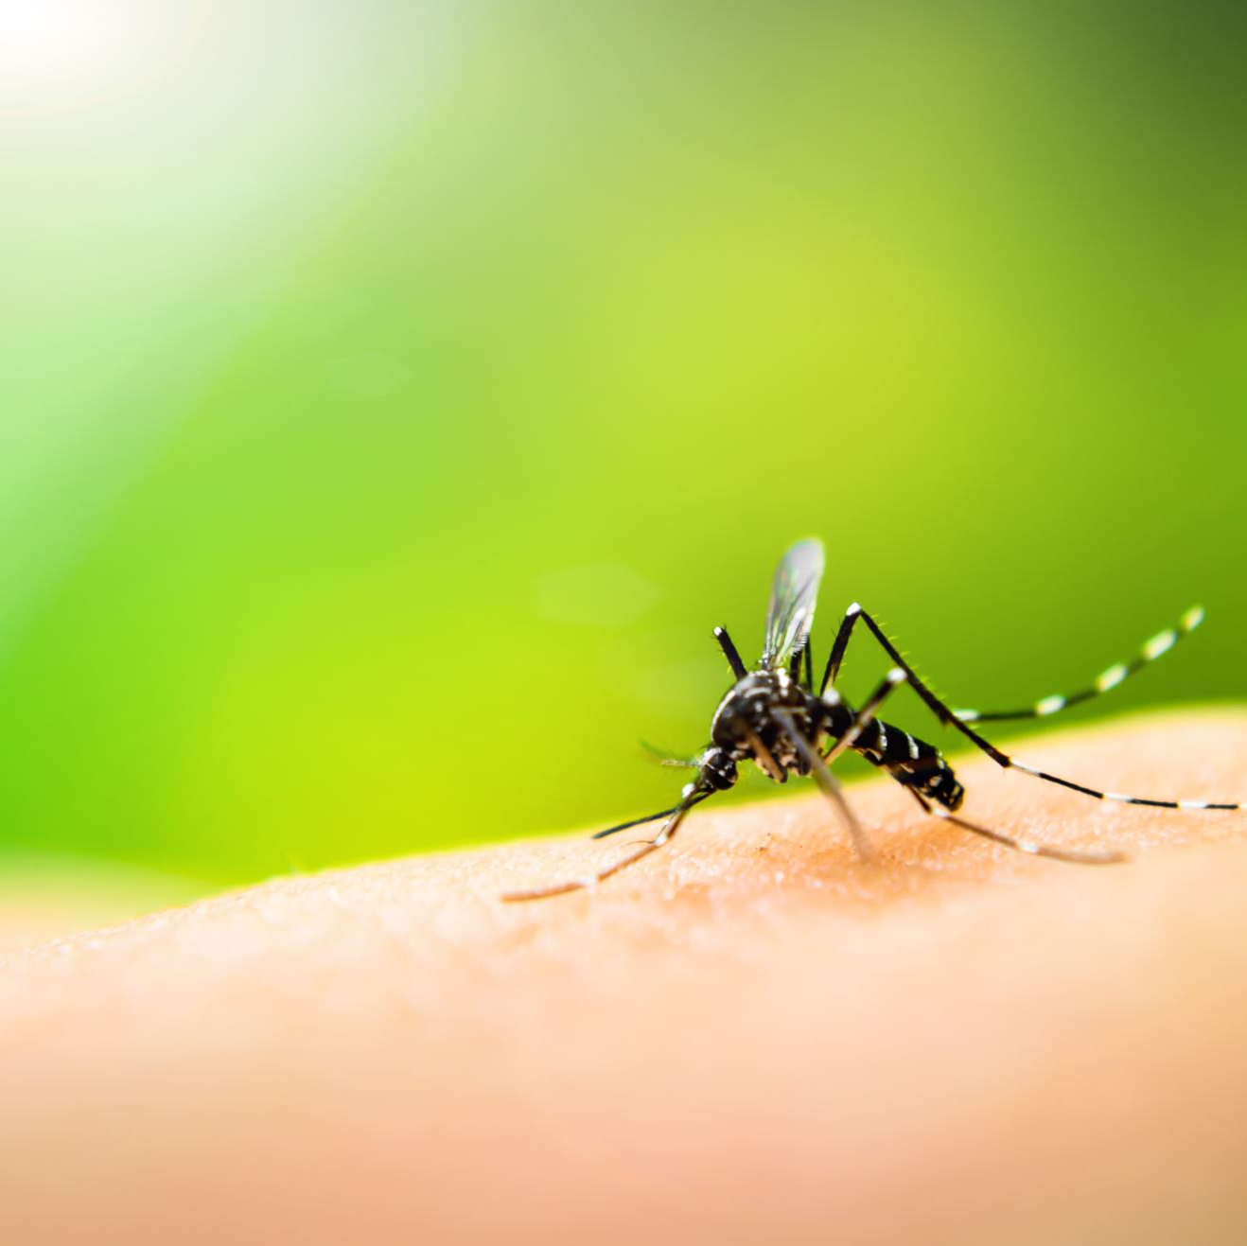
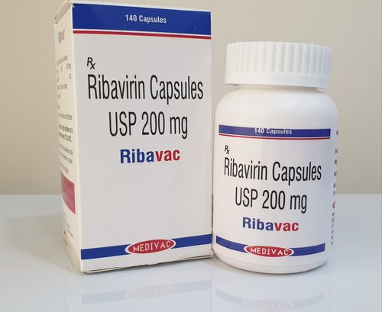
University of Basrah
AL-Zahraa College of Medicine
Ministry of higher Education and Scientific Research
Cchf
Role of ribavirin ?
Ribavirin, an anti-viral drug, has been effective in treating some individuals with Lassa fever, Crimean-Congo Haemorrhagic Fever and Haemorrhagic Fever with Renal Syndrome.
WHO Recommended regime (10 days)
30 mg / kg initial loading dose
15 mg / kg every six hour for four days
7.5 mg / kg every 8 hours for six days
In pregnancy : Risk Vs. Benefit

Slide 15
University of Basrah
AL-Zahraa College of Medicine
Ministry of higher Education and Scientific Research
Predictors of mortality
Clinical laboratory criteria that could be measured early in the course of disease (during the first 5 days) and that predicted a fatal outcome up to 90% of patients with any of these findings:
white blood cell count of 10 × 109 cells per L or above
platelet count of 20 × 109 per L or below
aspartate aminotransferase level of 200 U/L or over
alanine aminotransferase of 150 U/L or over
activated partial thromboplastin time of 60 seconds or more
fibrinogen levels of 110 mg/dl or under
Haematemesis, melena, and somnolence are significantly more common among patients with a fatal outcome.

Slide 16
University of Basrah
AL-Zahraa College of Medicine
Ministry of higher Education and Scientific Research
Prevention of CCHF infection can be achieved by
Avoiding or minimizing exposure to ticks by using tick repellent and wearing protective clothing.
Timely and correct removal of ticks.
Avoiding contact with the blood or tissue of infected animals and humans.
Using safe practices in meat processing plants.
Observing universal healthcare precautions.
Early diagnosis and barrier nursing of patients.

Slide 17
University of Basrah
AL-Zahraa College of Medicine
Ministry of higher Education and Scientific Research
Thank you

